Slide 1

Homicide over the past decade Project-4 Group-1 SMU Data Science Bootcamp
Sep-2023

Slide 2
Meet Our Team
Project Team Student Members :
Carlos Delarosa
Raj Agrawal
Ann Ly
John Banowsky
Faculty :
Alex Booth - Instructure
Sherhone Grant - TA
Sean Fleming - SSM

Slide 3
AGENDA
Introduction
Inspiration to select data
About Data
Analysis
Data cleaning
Website
Machine-learning
Tableau

Slide 4
Project Title & Description
Title - “Homicides over the past decade”
We have selected above as our Title / theme to perform the data analysis
PROJECT 4 - Our main purpose is to use a standard dataset and utilize various tools that we learn so far i.e. – machine learning, Tableau
Ability to connect to a file set
Ability to fetch data and organize them with various useable data frame
Perform supervised model / predictions
To use correlation and create various Bar, Donut, line charts using Tableau
Data Collection- The Washington Post collected data on more than 52,000 criminal homicides over the past decade in 50 of the largest American cities. The data included the location of the killing, whether an arrest was made and, in most cases, basic demographic information about each victim. Reporters received data in many formats, including paper, and worked for months to clean and standardize it, comparing homicide counts and aggregate closure rates with FBI data to ensure the records were as accurate as possible.

Slide 5
INSPIRATION
Why did you decide to use that topic? Inspiration, etc.
Carlos – My inspiration is to analyzing a homicides dataset to investigate how victim age influences arrest outcomes in cases
Raj – To learn more about homicides dataset and related investigation, and used acquired knowledge of the data science bootcamp for the data analysis. Eventually, participate in the volunteer program to help community to serve better.
Ann – I am interested in knowing more about the shared factors among all the homicide cases.
John – Homicides are never a good thing. Having a better understanding of which populations are affected will help us better address homicide to protect these demographics.

Slide 6
DATA
Source of DATASET – Kaggle.com
File Name 1 - homicide-data.csv (size : ~5MB ; ~52,000 records))
Link is as below----
https://www.kaggle.com/datasets/joebeachcapital/homicides
uid | reported_date | victim_last | victim_first | victim_race | victim_age | victim_sex | city | state | lat | lon | disposition
Alb-000001 | 20100504 | GARCIA | JUAN | Hispanic | 78 | Male | Albuquerque | NM | 35.0957885 | -106.5385549 | Closed without arrest
Alb-000002 | 20100216 | MONTOYA | CAMERON | Hispanic | 17 | Male | Albuquerque | NM | 35.0568104 | -106.715321 | Closed by arrest
Alb-000003 | 20100601 | SATTERFIELD | VIVIANA | White | 15 | Female | Albuquerque | NM | 35.086092 | -106.695568 | Closed without arrest
Alb-000004 | 20100101 | MENDIOLA | CARLOS | Hispanic | 32 | Male | Albuquerque | NM | 35.0784929 | -106.5560938 | Closed by arrest
Alb-000005 | 20100102 | MULA | VIVIAN | White | 72 | Female | Albuquerque | NM | 35.1303568 | -106.5809862 | Closed without arrest
Alb-000006 | 20100126 | BOOK | GERALDINE | White | 91 | Female | Albuquerque | NM | 35.15111 | -106.537797 | Open/No arrest
Alb-000007 | 20100127 | MALDONADO | DAVID | Hispanic | 52 | Male | Albuquerque | NM | 35.1117847 | -106.7126144 | Closed by arrest
Alb-000008 | 20100127 | MALDONADO | CONNIE | Hispanic | 52 | Female | Albuquerque | NM | 35.1117847 | -106.7126144 | Closed by arrest
Alb-000009 | 20100130 | MARTIN-LEYVA | GUSTAVO | White | 56 | Male | Albuquerque | NM | 35.0753799 | -106.5534583 | Open/No arrest
Alb-000010 | 20100210 | HERRERA | ISRAEL | Hispanic | 43 | Male | Albuquerque | NM | 35.0659296 | -106.5722875 | Open/No arrest

Slide 7
PLANNING
Color palette
Mixed selection – low gray
Expected Outcome - of the data analysis
What are at least THREE research questions you want to explore/answer in this data source?
How race / age data summaries
Homicide over a period of time
Census data merge with homicide data to see population / demographic
Additional Research Questions to Answer
Per 100,000 rate of homicides

Slide 8
DATA CLEANING
xxxxxxxxxxxxxxxxxxxxxxxxxxxxxxxxxxxxxxx
xxxxxxxxxxxxxxxxxxxxxxxxxxxxxxxxxx

Slide 9

WEBSITE DEVELOPMENT
Capturing the audience attention with a video background
Respecting the Topic with the tones of color

Slide 10
WEBSITE DEVELOPMENT
Embedding Ydata for dataset profiling
Overview of our dataset

Slide 11
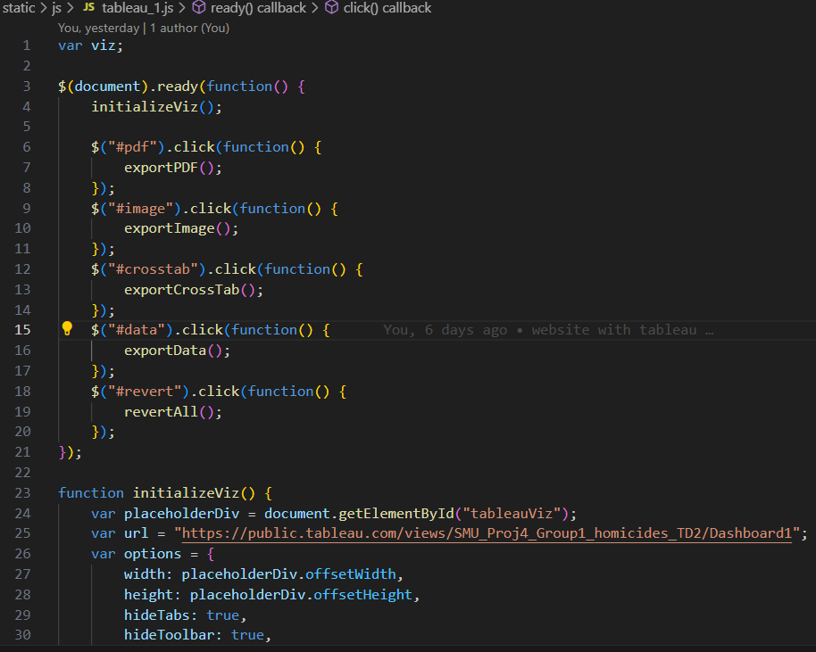
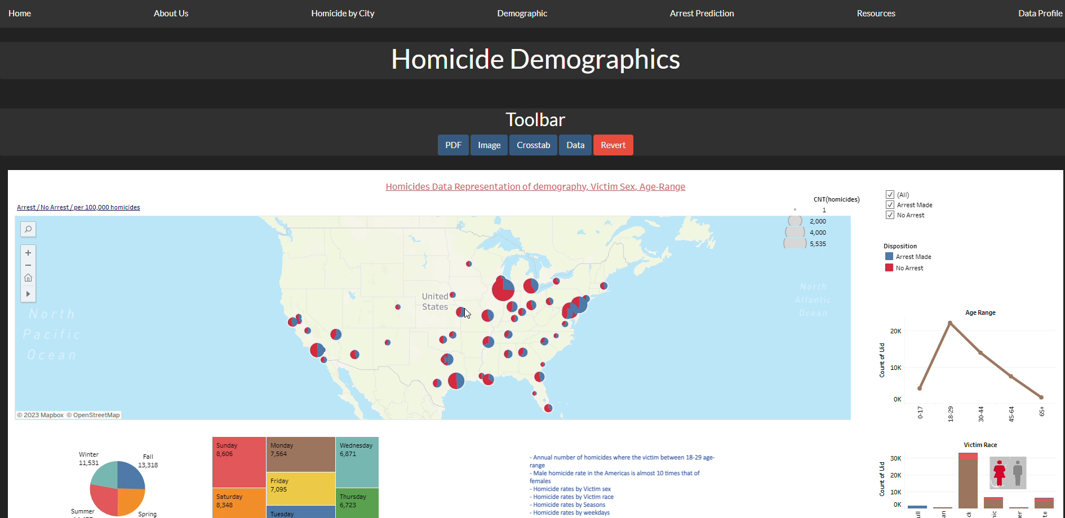
WEBSITE DEVELOPMENT
Calling API
Tableau page

Slide 12
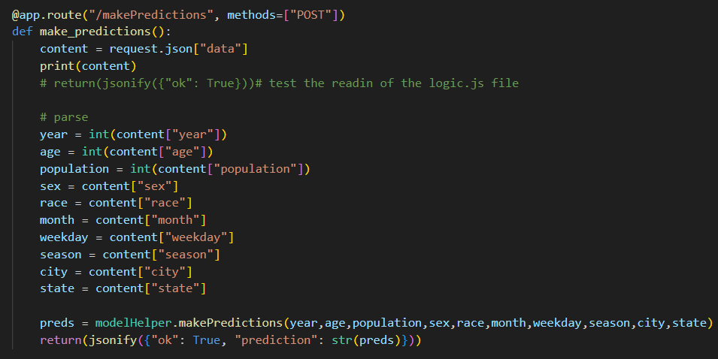
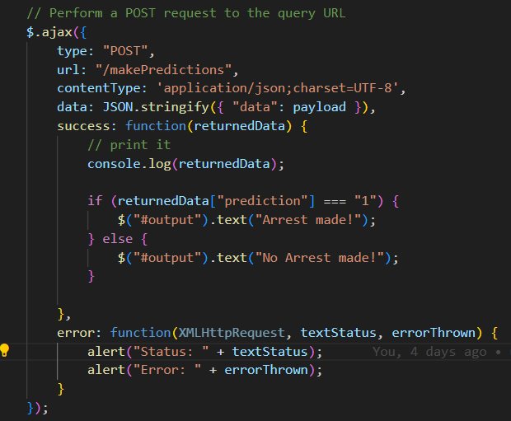
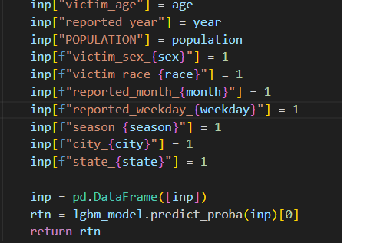
WEBSITE DEVELOPMENT
Prediction form Challenges

Slide 13
MACHINE LEARNING
xxxxxxxxxxxxxxxxxxxxxxxxxxxxxxxxxxxxxxx
xxxxxxxxxxxxxxxxxxxxxxxxxxxxxxxxxx

Slide 14
DATA VISULASIZATION - TABLEAU
xxxxxxxxxxxxxxxxxxxxxxxxxxxxxxxxxxxxxxx
xxxxxxxxxxxxxxxxxxxxxxxxxxxxxxxxxx

Slide 15

Q&A
References
xxxxxxxxxxxxxxxxxxxxxxxxxxxxxxxxxx

